Slide 1
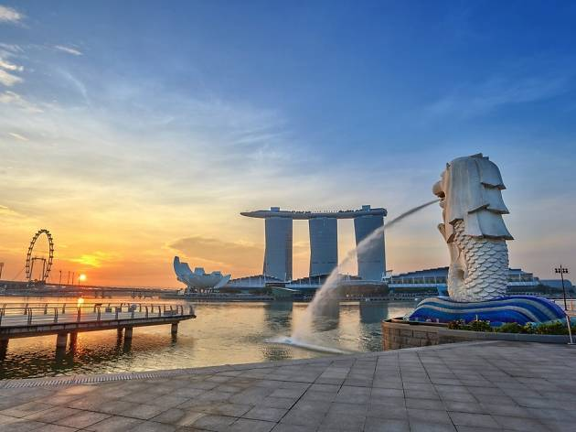
亞太地區發展新訊
澳洲
台灣
香港
新加坡
2003
2005
2007
2015
Notes:
United States, Canada, Mexico, Bahamas, Columbia, Dominican Republic, Ecuador, Panama, Jamaica
United Kingdom, Spain
Australia, Taiwan, Hong Kong, Singapore, New Zealand

Slide 2
為什麼你需要發展海外市場?
☞ 在海外認識任何人?
☞ 不時前往海外?
☞ 擁有海外SHOP.COM網站!
☞ 賺更多錢?

Slide 3
2016 美安亞太地區表現
挑戰獎得主
 36 %
SABP購物年金合格人數
83%
Master UFO 卓越超連鎖®店主
58%

Slide 4
2016 美安亞太地區表現
夥伴商店
 17%
招募
 19%
BV 佣金
 33%

Slide 5
UFO 成長
SHOP.COM:
GMTSS, SABP, MUFO
SHOP.COM 卡
Google 地圖
與 UOB 促銷合作
2017 發展重點
新加坡

Slide 6
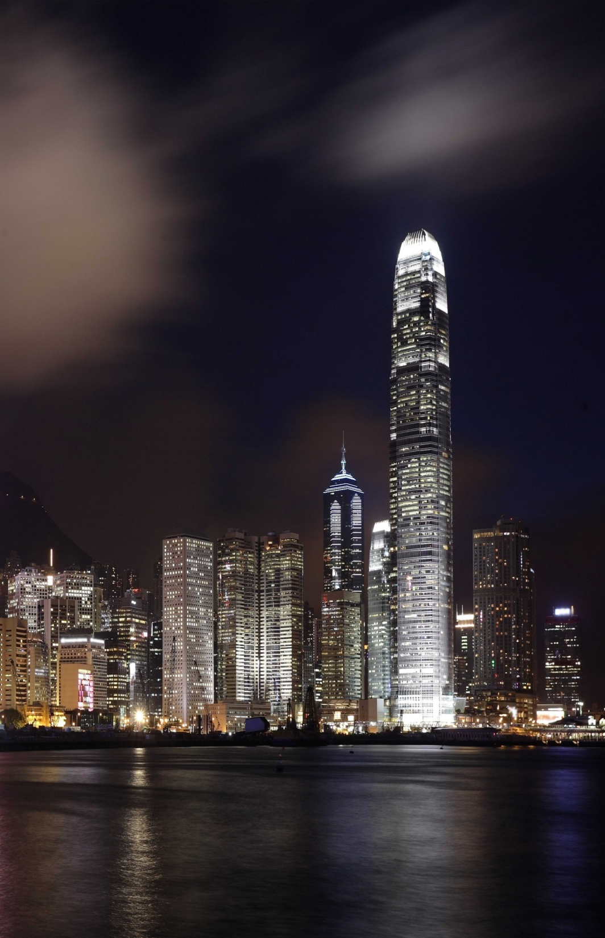
UFO 成長
SHOP.COM:
GMTSS, SABP, MUFO
Ztore 共同公益活動
2017 發展重點
SHOP.COM 說明圖冊
伙伴商店商户應用程式
新加坡
香港

Slide 7
UFO growth :
GMTSS, SABP, MUFO
SHOP.COM:
媒體合作
2017 發展重點
救地球造林公益計畫
大型知名夥伴商店合作
台灣

Slide 8
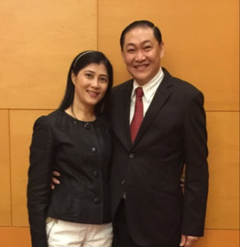
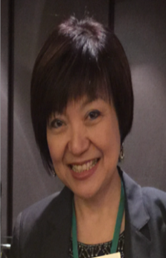
亞太地區領袖群英榜

Slide 9
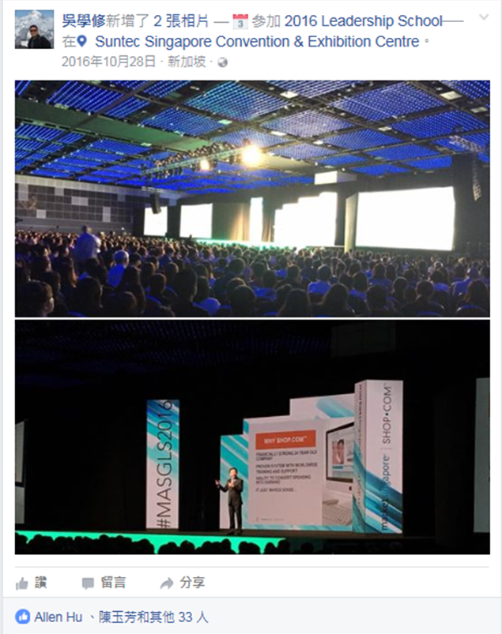
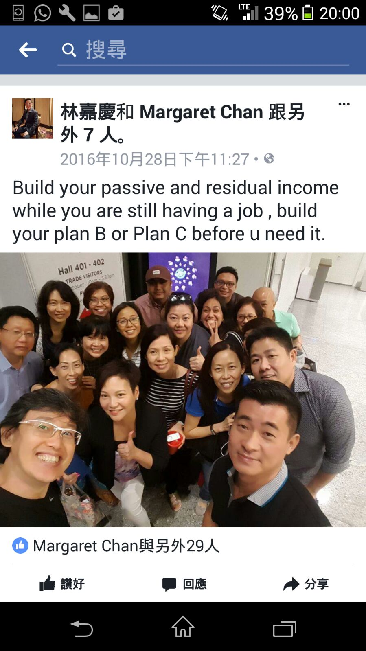
亞太地區領袖發展海外事業

Slide 10
亞太地區最新發展
澳洲
台灣
香港
新加坡
馬來西亞
即將開業
2003
2005
2007
2015
Notes:
United States, Canada, Mexico, Bahamas, Columbia, Dominican Republic, Ecuador, Panama, Jamaica
United Kingdom, Spain
Australia, Taiwan, Hong Kong, Singapore, New Zealand

Slide 11
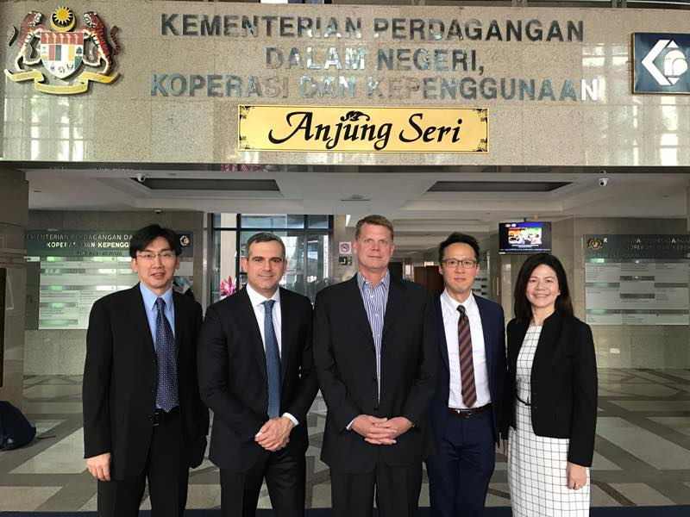

Slide 12
CHERIE FOONG
美安馬來西亞
總經理

Slide 13
美安馬來西亞 最新資訊

Slide 14
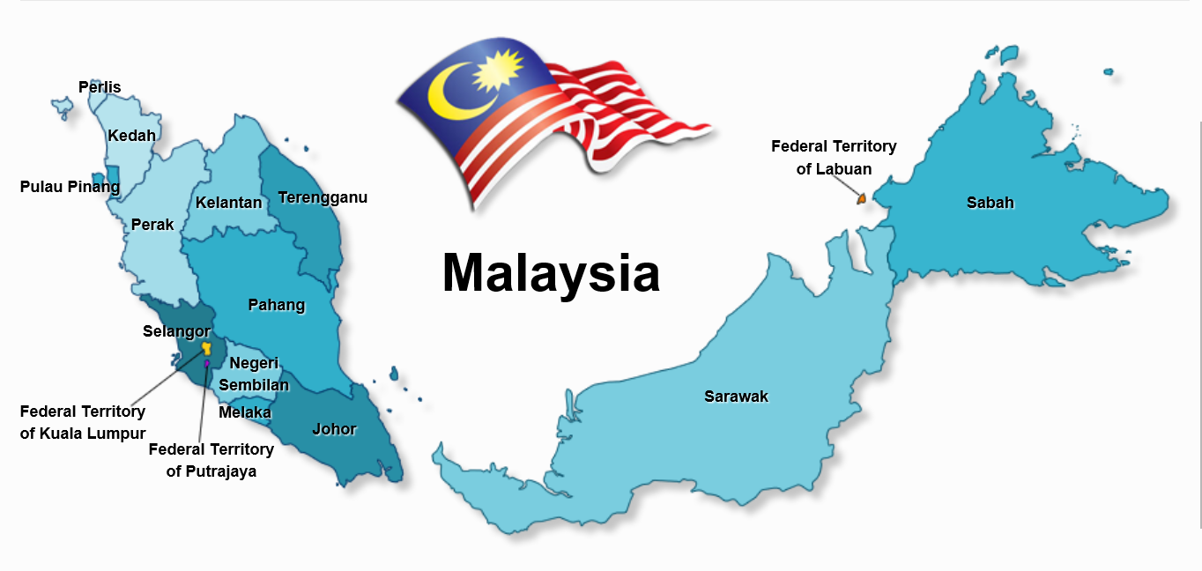
馬來西亞

Slide 15
CHERIE FOONG
在相關產業超過15年經驗，主要負責經銷商服務以及業務部門。
過去負責開拓馬來西亞以及越南分公司
My Email: cherief@marketmalaysia.my

Slide 16
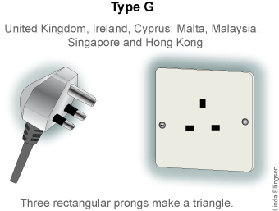
基本資訊
熱帶性氣候全年溫暖
氣溫一般在21ºC to 32ºC 之間
與台灣同時區
電壓220-240V，標準三針插座，與香港以及新加坡一樣。
幣別：馬幣(RM)。匯率大約是 USD1=RM4.4，可以在銀行或者是一般貨幣兌換點換馬幣。

Slide 17
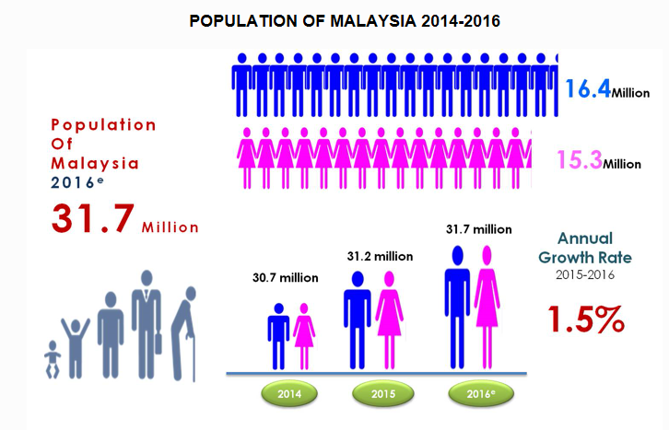
人口
資料來源：馬來西亞政府主計處. July 2016

Slide 18
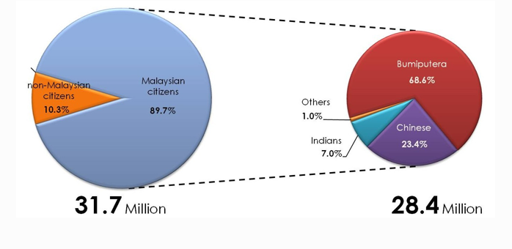
各民族人口以及使用之語言
官方語言：馬來話
常用語言：英文、普通話
方言： 廣東話、福建話、客語、海南話、福州話
資料來源：馬來西亞政府主計處. July 2016
Notes:
Trilingual Support

Slide 19
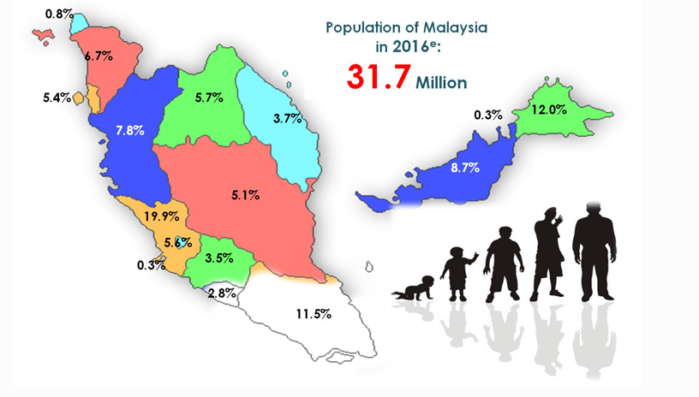
各州人口
區域 | 人口數('000) | 佔比 (%)
中區 | 9,447 | 29.8%
北區 | 6,562 | 20.7%
南區 | 4,533 | 14.3%
東海岸 | 4,596 | 14.5%
Sabah | 3,804 | 12%
Sarawak | 2,758 | 8.7%
總計 | 31,149 | 100%
資料來源：馬來西亞政府主計處. July 2016
Notes:
Online GMTSS
Satellite Offices

Slide 20
商機無限 – 馬來西亞直銷之市場發展
2016年的發展相較於2015年更加強勁。
馬來西亞消費者一直都相當歡迎直銷。
Sources: Euromonitor/Malaysia/2016

Slide 21
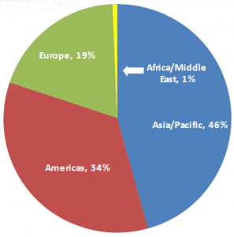
商機無限 – 馬來西亞直銷市場
馬來西亞是2015年世界直銷市場的第9大國家。
亞太地區的第4大國家。
總人口的14%(430萬)從事直銷行業
資料來源: WFDSA report of 2015 ASENSHIA, World Bank, WFDSA, Euromonitor, Wikipedia, CAGR: Compound Annual Growth Rate expressed in Constant USD 2014, between 2011 and 2014
亞太地區是世界直銷版圖中最大的區域，佔全球46％。
Notes:
WFDSA reports the sales volume generated in 2015 by its member countries as $184 billion and the number of individual direct sellers as 103 million. The number of direct sellers do not include those who are in China as this country’s figure was not reported. The sales volume in 2015 represents a 7.7% growth from the previous year in constant Dollars.
As the chart to the right shows, Asia-Pacific remains to be the world’s largest direct selling region with a 46% share
The top ten markets are ranked, together with their shares in the global volume, as follows: US (20%), China (19%), South Korea (9%), Germany (8%), Japan (8%), Brazil (5%), Mexico (4%), France (2%), Malaysia (2%), and UK (2%). In 2011, while the US was at 20%, China’s share was 11%.
GDP Growth Constant USD 2014: 6%
YoY Industry Growth Constant USD 2014: 5%
Malaysia is the #1 market for Direct Selling within the South East Asia region representing 5.3 billion USD in 2014.
With a population of 4.3 million Direct Sellers, almost 1 out of 6 people of the population is involved in Direct Selling. Founded in 1978 the Direct Selling Association of Malaysia (DSAM) is well established and played an important role in aiding the industry professionalization, implementing regulations without limiting its development.

Slide 22
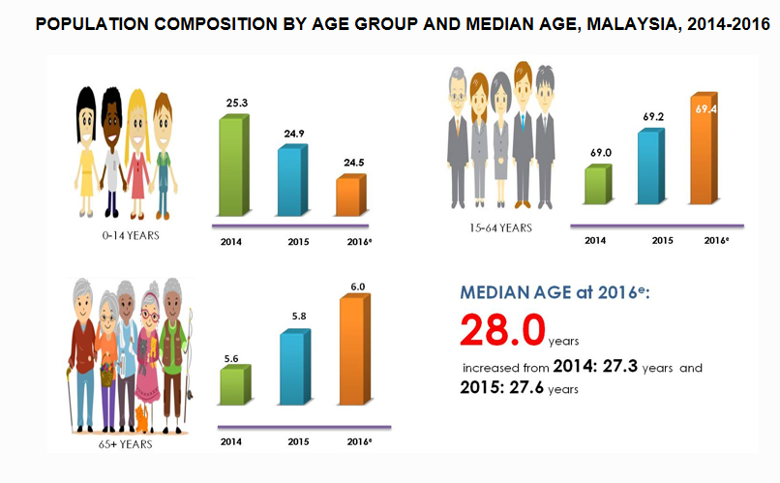
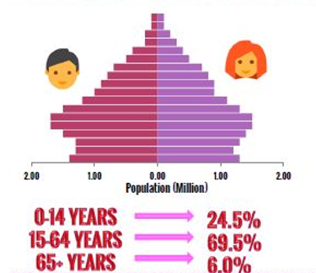
商機無限 - 人口老化、健康意識抬頭
資料來源: The Office of Chief Statistician Malaysia. July 2016
Notes:
The ageing population in Malaysia coupled with rising consumer health consciousness spurred the performance of dietary supplements. Consumers were looking for early prevention, and coupled with their rising disposable incomes, they were more willing to invest in dietary supplements.
Product Categories (by WFDSA 2015)
In 2015, wellness category was the largest one globally with 34% share. Cosmetics category produced 32% of the volume. Household goods and durables accounted for 11%, and clothing and accessories for 7%.
Region-wise wellness was the strongest in Asia-Pacific (41%). In fact, its share was 89% in Philippines, 64% in Hong Kong, and 63% in Taiwan. This category was the weakest in Americas (29%).

Slide 23
商機無限 - 馬來西亞的肥胖統計數字已經響起警鐘
吉隆坡, 馬來西亞
2016.2.3 馬來西亞是亞洲地區最胖的國家，2015年的肥胖人口成長率繼續成長中，總人口中大約有3千萬人有過重、肥胖的問題。
肥胖的馬來西亞人佔總人口的17.7％，而整個過重的人口佔總人口的30％
Sources: Health Minister Datuk Seri Dr S. Subramaniam, according to the National Health and Morbidity Survey of 2015,

Slide 24
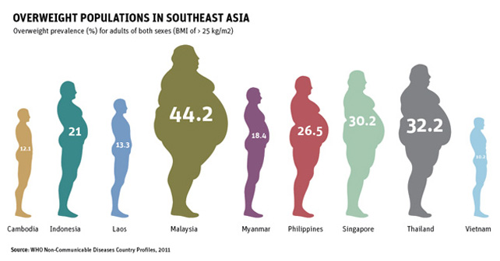
商機無限 - 馬來西亞的肥胖問題已經響起警鐘
一半的馬來西亞人口有過重或者是糖尿病的問題，政府當局認為高卡路里飲食以及久坐不動的生活方式是罪魁禍首。

Slide 25
商機無限 – 電子商務潛力無窮
馬來西亞的電子商務潛力無窮，網路用戶超過2千萬人（佔總人口63%），而且持續成長中。
電子商務佔全國GDP的 5.8％
資料來源： http://www.thestar.com.my/news/nation/2017/01/30/big-potential-for-ecommerce-malaysia-is-well-on-track-to-grow-within-the-industry-says-liow/#Og5E7tFgyCJvqedY.99
Notes:
The prime minister in his 2017 Budget Speech unveiled the country’s ambition to launch the world’s first Digital Free Trade Zone.
World renowned e-commerce legend – Jack Ma, the founder and executive chairman of Alibaba Group – as Malaysia’s digital economy advisor would be a boost to the country’s e-commerce sector and also create new opportunities
the launch of the Digital Free Trade Zone scheduled for March.

Slide 26
美安馬來西亞分公司組織架構
Country Manager
Sales & Event
Product Marketing
Logistic & Distribution
HR & Administration
Communication
Affiliates Development
UnFranchise Service Manager

Slide 27
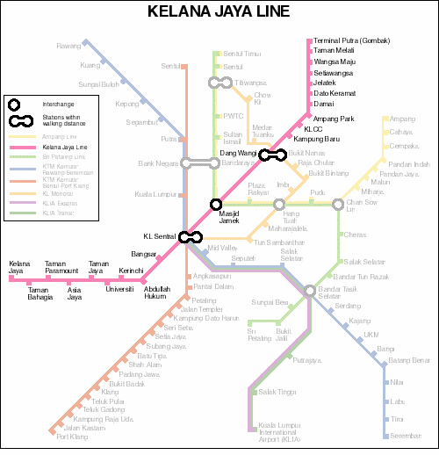
美安馬來西亞
Notes:
Location, mention it “start with KL, and will develop in time across country”. You can show a few major district in KL, and then mention the company is considering one of these locations due to…..
Set up Structure – SHOWCASE to provide self-service & pick-up services. You can mention the delivery service will be arranged across the whole country.

Slide 28
美安馬來西亞 – 產品

Slide 29
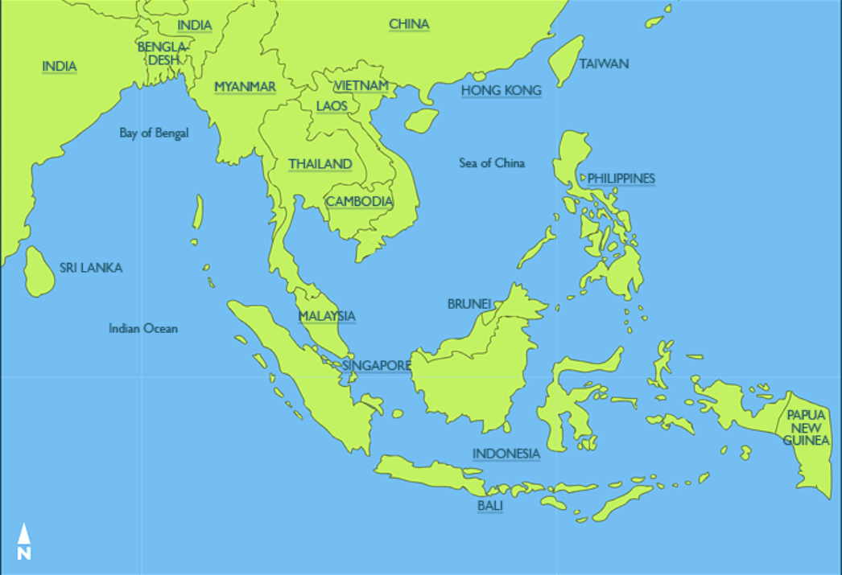
亞太地區第5個國家
Notes:
5th location after showing Australia, Taiwan, Hong Kong, and Singapore. Mention with Malaysia having a strong base of Malay and Muslim, we hope the success of Malaysia will start the journey to develop other SEA markets in the region.

Slide 30
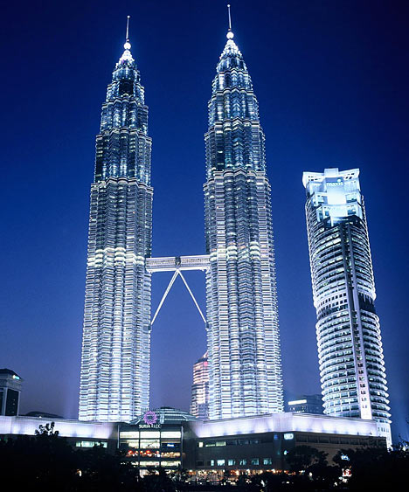
馬來西亞見！
Notes:
First nationwide event in Spring 2018

